Slide 1
DETECTION OF MALARIAL PARASITES IN BLOOD SAMPLES USING IMAGE PROCESSING, MACHINE LEARNING AND DEEP LEARNING
MEMBERS:
M.SHYAM GANESH [310616106131]
M.SWARNA [310616106150]
N.M.VISHAL KANNA [310616106169]
PROJECT GUIDE:
Mrs. A.USHA
DESIGNATION:
ASSOCIATE PROFESSOR

Slide 2
OUTLINE
OBJECTIVE
INTRODUCTION
TYPES OF MALARIAL PARASITES
PRE-REQUISITES
LITERATURE SURVEY
EXISTING SYSTEM
PROPOSED SYSTEM
BLOCK DIAGRAM
TOOLS USED
RESULTS
COMPARATIVE ANALYSIS
PERFORMANCE ANALYSIS - CHARTS
CONCLUSION & FUTURE SCOPE
TIMELINE CHART
JOURNAL PUBLICATION
REFERENCES
CERTIFICATES

Slide 3
OBJECTIVE
To devise an automated and accurate system to identify the type of malarial parasite in blood samples.
To develop an efficient method for malarial diagnosis.

Slide 4

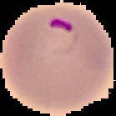
INTRODUCTION
Malaria is a dreadful disease in the hematological field causing millions of death.
Slow diagnosis and inept treatment of malaria is the reason for steep increase in death rate.
SYMPTOMS: high fever, profuse sweating, headache, nausea, vomiting, abdominal pain, diarrhoea
REQUIREMENT: Rapid diagnosing method and proper medication.
TREATMENT: Malarial analysis is based on microscopic examination of blood films.
Fig. Healthy blood cell
Fig. Malaria infected blood cell

Slide 5
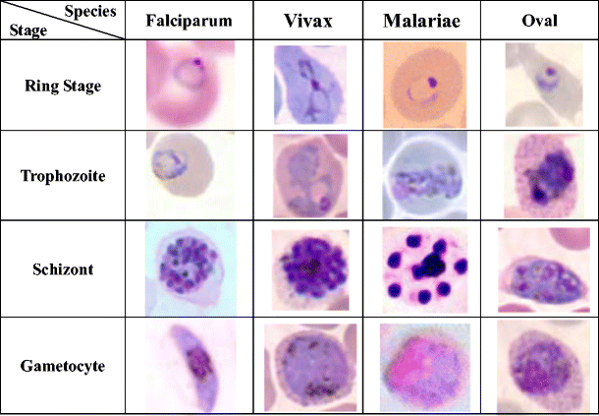
TYPES OF MALARIAL PARASITES
TYPES OF MALARIAL SPECIES:
Plasmodium falciparum
Plasmodium vivax
3. Plasmodium malariae
4. Plasmodium ovale
Fig. Stages in growth and development of a malarial parasite in a blood cell

Slide 6
PRE-REQUISITES
For malaria parasite detection, the classifiers used are:
Machine Learning domain- SUPPORT VECTOR MACHINE(SVM)
Deep Learning domain- CONVOLUTIONAL NEURAL NETWORK(CNN)

Slide 7
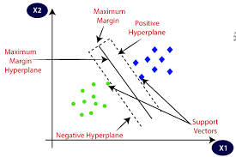
SUPPORT VECTOR MACHINE (SVM)
A support-vector machine constructs a set of hyperplanes in an infinite-dimensional space.
Value of each feature denotes the value of a particular coordinate
An hyperplane differentiates the two classes.
APPLICATIONS: Classification, Regression and Outliers detection.
Fig. Hyperplane support vector machine algorithm

Slide 8

CONVOLUTIONAL NEURAL NETWORK (CNN)
A class of deep neural networks.
The multiple layers of the network employs a mathematical operation called convolution.
Convolution is used to replace conventional matrix multiplication.
APPLICATIONS: Computer vision, action recognition, document analysis and mainly natural language processing.
Fig. Neural network layer architecture

Slide 9
LITERATURE SURVEY
[1]ABO Blood Group Detection Based on Image Processing Technology
Author: Min Liu, Nian Chen, Shi Chen, Wei-wei Fu, Yue-fang Dong and Zhe Zhou
Publisher: IEEE 2nd International Conference on Image, Vision and Computing (ICIVC)
Year: 2017
Inference:
A rapid blood group analyzer is used for blood group detection.
The median filter is used to suppress the noise to get the best approximation of the original image.
The characteristic parameters of ABO blood group are extracted according to the gray level distribution of the image.
Over-dependency on rapid blood group analyzer.

Slide 10
LITERATURE SURVEY(Contd.,)
[2]Image Processing Based Detection & Classification of Blood Group Using Color Images
Author: Abubakar Yamin, Faisal Irnran , Syed Hassan Tanvir and Usman Akbar
Publisher: IEEE International Conference on Communication, Computing and Digital Systems (C-CODE)
Year: 2017
Inference:
Pre-processing techniques, HSV Luminance and morphological operations are used to detect blood group of images.
SIFT features that lead to the classifier for recognition was not extracted.

Slide 11
LITERATURE SURVEY(Contd.,)
[3]Design a new algorithm to count white blood cells for classification Leukemic Blood Image using machine vision system
Author: Alireza Karimian and Zahra Khandan Khadem Alreza
Publisher: IEEE 6th International Conference on Computer and Knowledge Engineering (ICCKE)
Year: 2016
Inference:
White blood cells are identified using color space conversion models.
Leukocytes group are separated using division of watershed conversion and image cleanup is done.
Problems of data extraction from WBCs- loosing form, dimensions and edges.
It showed an accuracy of 93% in the detection of white blood cells.

Slide 12
LITERATURE SURVEY(Contd.,)
[4]Real Time Blood Image Processing Application for Malaria Diagnosis Using Mobile Phones
Author: Corentin Dallet, Izzet Kale and Saumya Kareem
Publisher: IEEE International Symposium on Circuits and Systems (ISCAS)
Year: 2014
Inference:
A fast and reliable mobile phone Android application platform for blood image analysis is developed.
The application is based on novel Annular Ring Ratio Method, tested and validated in MATLAB.
The method detects the blood components such as the Red Blood Cells (RBCs), White Blood Cells (WBCs), parasitemia of the parasites in the infected RBCs.

Slide 13
LITERATURE SURVEY(Contd.,)
[5]A Novel Method to Count the Red Blood Cells in Thin Blood Films
Author: I.Kale, S.Kareem and R.C.S Morling
Publisher: IEEE International Symposium on Circuits and Systems (ISCAS)
Year: 2011
Inference:
The method utilizes basic knowledge on cell structure and brightness of the components to detect the RBCs in the image.
Eliminates the segmentation procedures used to segment the cells in the microscopic image.
Avoids image pre-processing to deal with non uniform illumination prior to cell detection.
A global threshold was used for classification of pixels to either foreground or background.
It showed an accuracy of 95% in the detection of red blood cells.

Slide 14
EXISTING SYSTEM
Lacks at extracting many valid features during pre-processing.
Many classifiers used are incompatible with blood sample images.
A comparative analysis to find a suitable classifier isn’t done.
Accuracy is not reliable.
Features extracted normally- Contrast, Correlation, Colour Histograms, Energy and Homogeneity.

Slide 15
PROPOSED SYSTEM
Many features are considered to increase the accuracy of the detection process.
A comparative analysis of SVM and CNN algorithm outputs is done.
Convolutional Neural Network was found to be more precise and accurate than SVM algorithm.

Slide 16
BLOCK DIAGRAM
Pre-processing
(Resizing,
De-noising,
Image enhancement)
Image segmentation
(Bimodal threshold detection)
Feature extraction
(SIFT algorithm)
Input sample images of malaria affected blood cells (.png files)
Plasmodium falciparum
Classification using different classifiers
(SVM and CNN)
Plasmodium vivax
Plasmodium malariae
Plasmodium ovale

Slide 17
BLOCK DIAGRAM EXPLANATION
IMAGE ACQUISITION: A database of stained blood smeared images was procured in PNG format from the following links: https://www.kaggle.com/iarunava/cell-images-for-detecting-malaria
https://lhncbc.nlm.nih.gov/publication/pub9932
PRE-PROCESSING: Resizing: Images were resized from dimensions of range (80-300) X (80-300) to 256 X 256
Elimination of noise: Median filter was used
Enhancement of image contrast: In-built filtering techniques(morphological operation) were
applied
SEGMENTATION: Bi-modal threshold detection was used to differentiate useful information of blood cells from
the background
Threshold value used- 0.45(based on trail and error method)

Slide 18
BLOCK DIAGRAM EXPLANATION(Contd.,)
FEATURE EXTRACTION: The desired features were extracted from the images using Scale-Invariant Feature Transform (SIFT) based on Euclidean distance
Contrast (CTR): Obtained by change in brightness of image from one pixel to another using data cursor (in-built feature)
Correlation (COR): Correlation is a measure of gray level linear dependence between the pixels at the specified position
relative to each other
Homogeneity (IDM): It is the uniformity in composition. Also known as Inverse Difference Moment(IDM)

Slide 19
BLOCK DIAGRAM EXPLANATION(Contd.,)
Energy (E): Determines the intensity of pixels. Calculated as follows:
Entropy (H): Statistical measure of randomness used to characterize texture of image. Calculated as follows
CLASSIFICATION: The processed image was classified using SVM and CNN classifiers
IDENTIFICATION: The type of malaria causing species was identified

Slide 20
TOOLS USED
HARDWARE:
Processor: Pentium dual core 2.00 GHz
Disk space: 40 GB
RAM: 4GB (Minimum)
SOFTWARE:
MATLAB R2018a
C language
IMAGES USED:
75% for Training and 25% for Testing
Total images used for training and testing: SVM algorithm- 100 .png images per species type
CNN algorithm- 1000 .png images

Slide 21
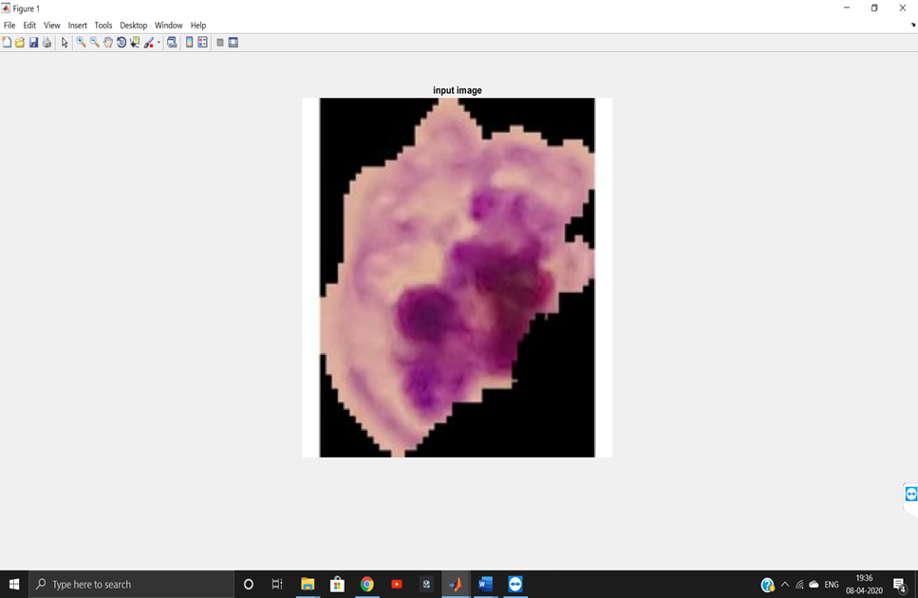
RESULTS - SVM OUTPUT - SPECIES TYPE 1
Fig. Input blood sample image of species type-1

Slide 22
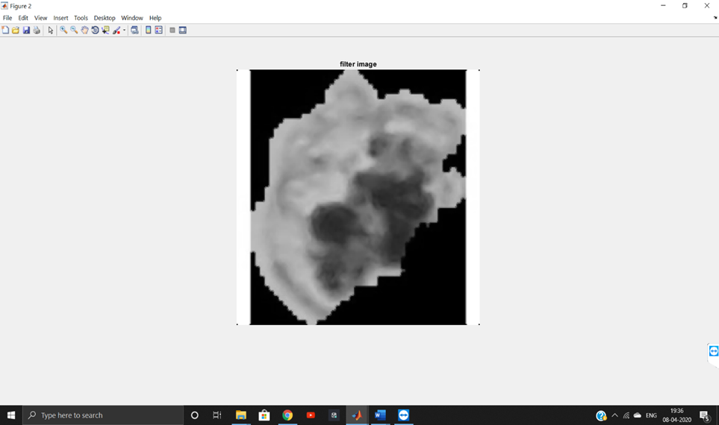
RESULTS - SVM OUTPUT(Contd.,)
Fig. Filtered input image

Slide 23
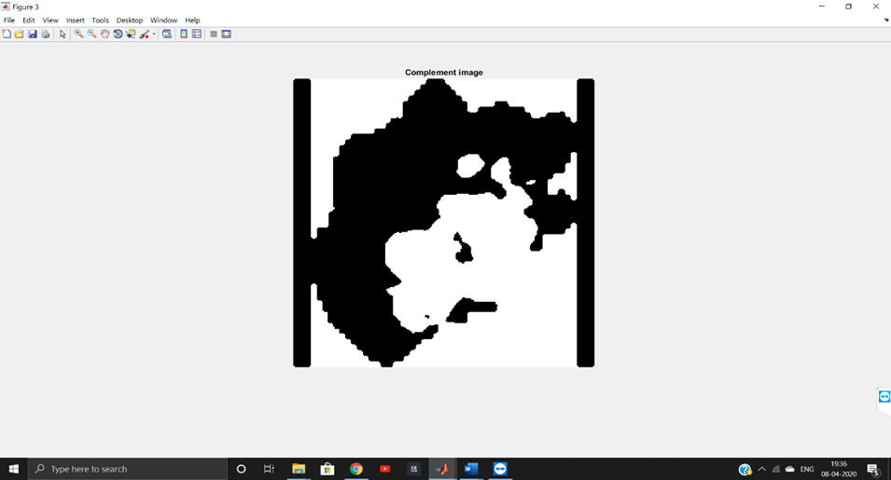
RESULTS - SVM OUTPUT(Contd.,)
Fig. Binary converted image of the corresponding filtered image

Slide 24
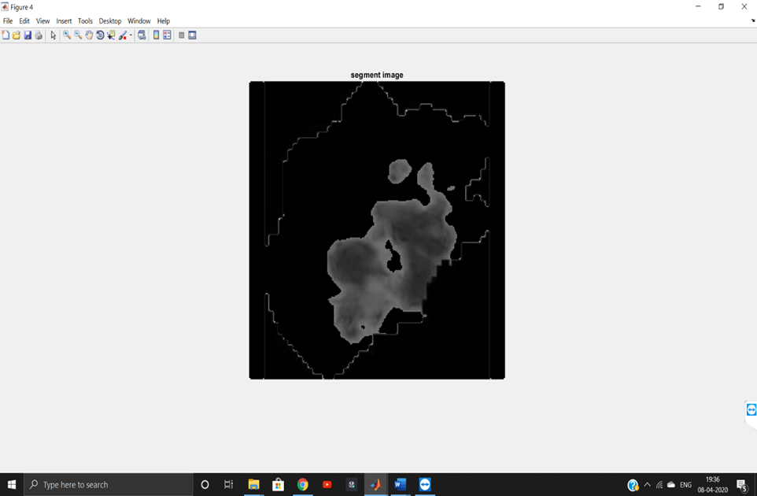
RESULTS - SVM OUTPUT(Contd.,)
Fig. Segmented image

Slide 25
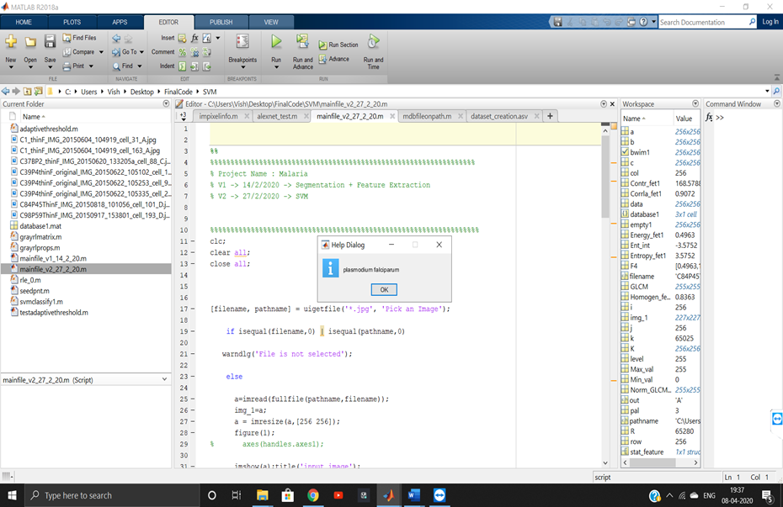
RESULTS - SVM OUTPUT(Contd.,)
Fig. Species of malarial parasite is identified

Slide 26
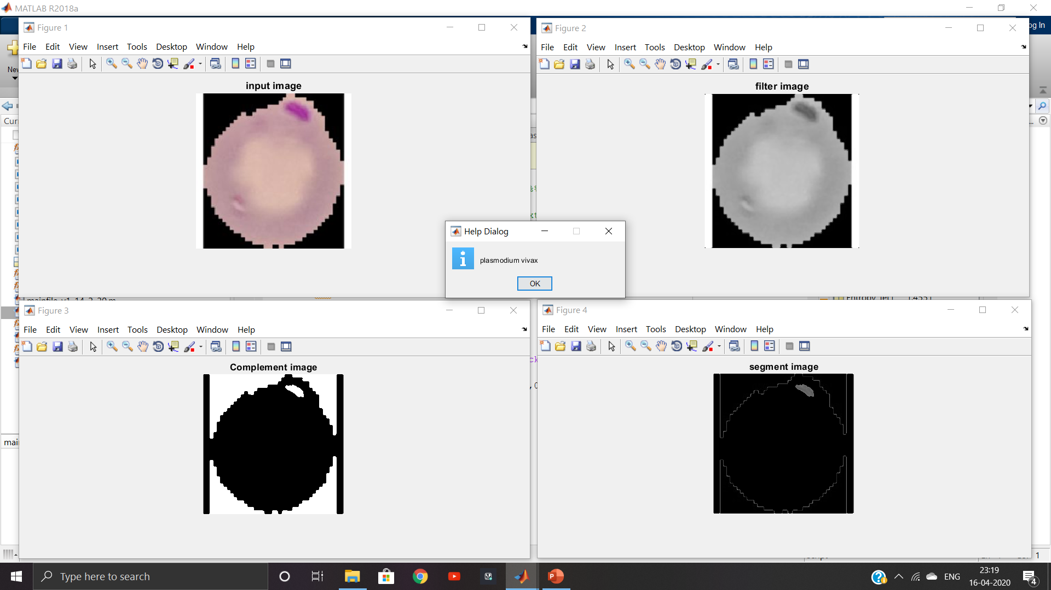
RESULTS - SVM OUTPUT - SPECIES TYPE 2
Fig. Consolidated output of species type- 2

Slide 27
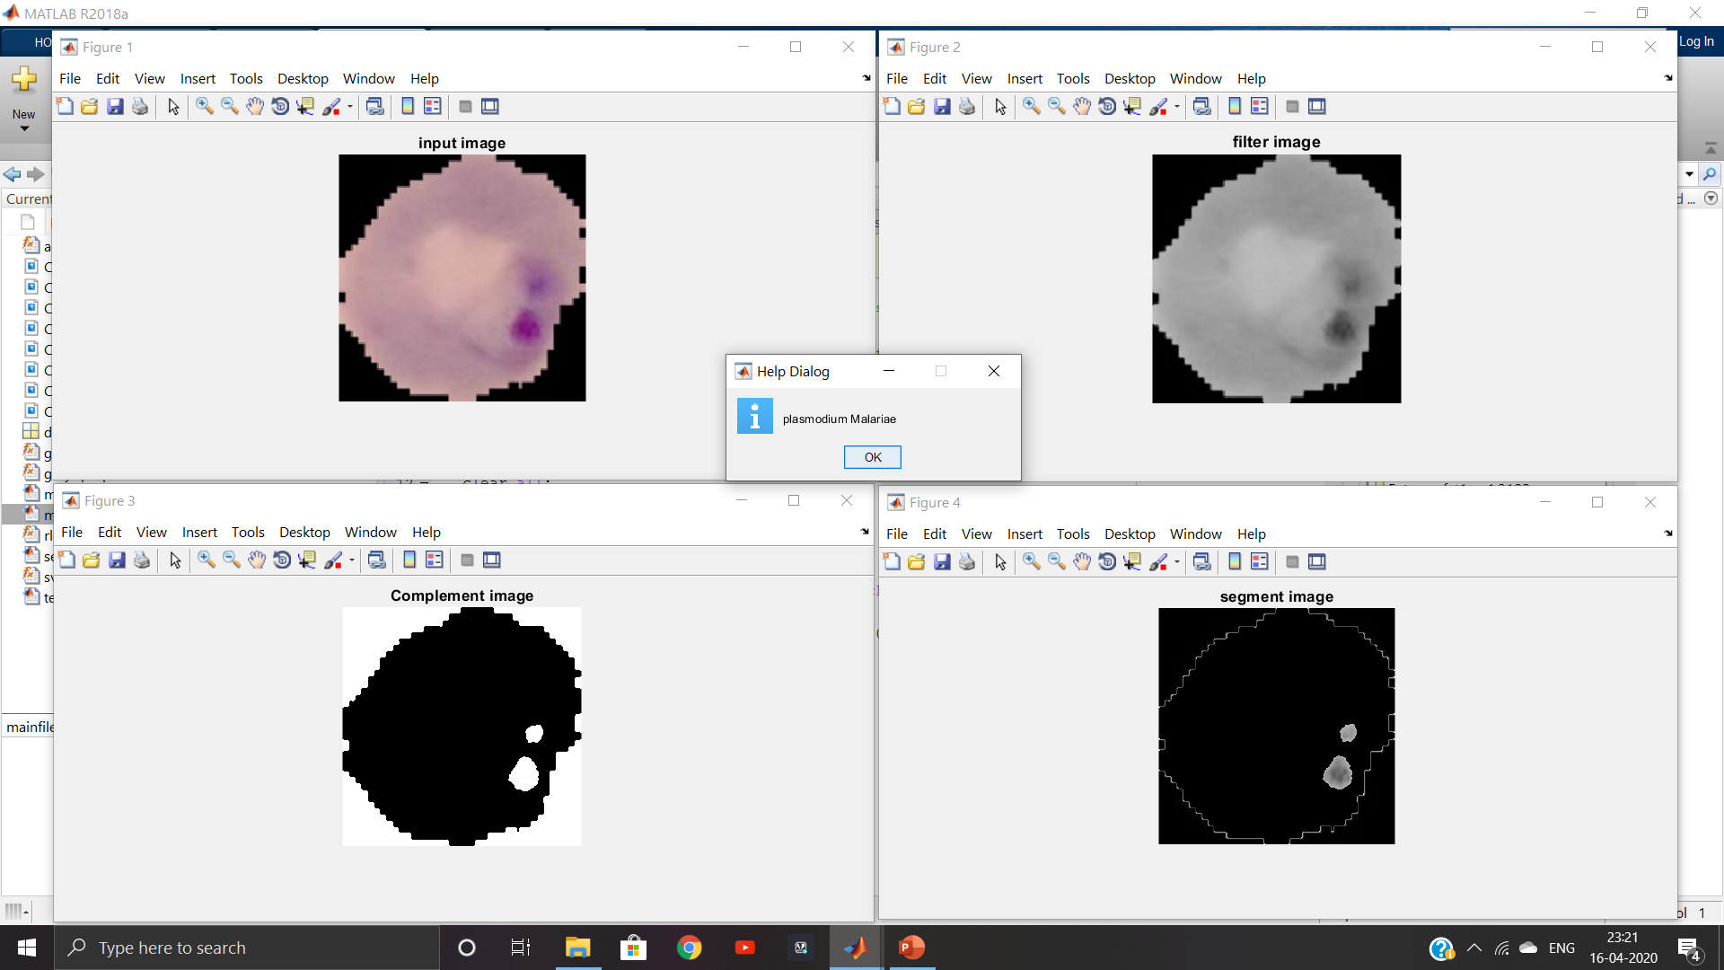
RESULTS - SVM OUTPUT - SPECIES TYPE 3
Fig. Consolidated output of species type- 3

Slide 28
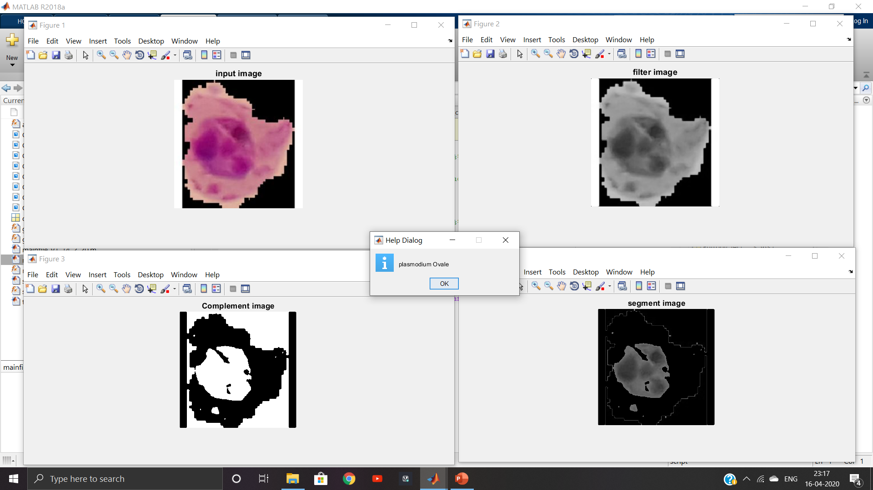
RESULTS - SVM OUTPUT - SPECIES TYPE 4
Fig. Consolidated output of species type- 4

Slide 29
RESULTS - SVM OUTPUT - STATISTICAL FEATURES
Species Type Statistical Features | Plasmodium falciparum | Plasmodium vivax | Plasmodium malariae | Plasmodium ovale
Contrast | 204.8366 | 234.2128 | 146.0947 | 210.5449
Correlation | 0.5011 | 0.5030 | 0.5649 | 0.9107
Energy | 0.6830 | 0.7486 | 0.7872 | 0.4943
Homogeneity | 0.8968 | 0.9200 | 0.9316 | 0.8372
Entropy | 1.8376 | 1.4551 | 1.3216 | 3.5631

Slide 30
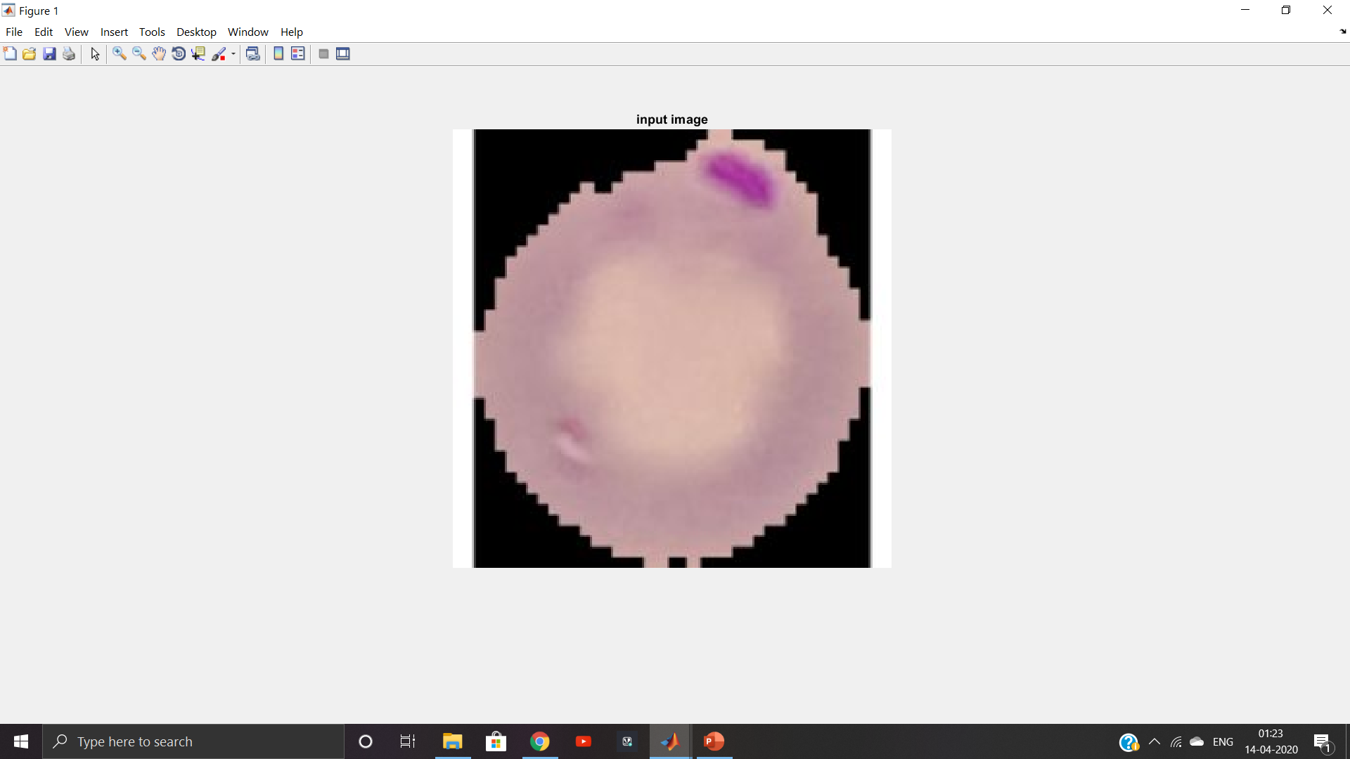
RESULTS - CNN OUTPUT - SPECIES TYPE 1
Fig. Input blood sample image of species type-1

Slide 31
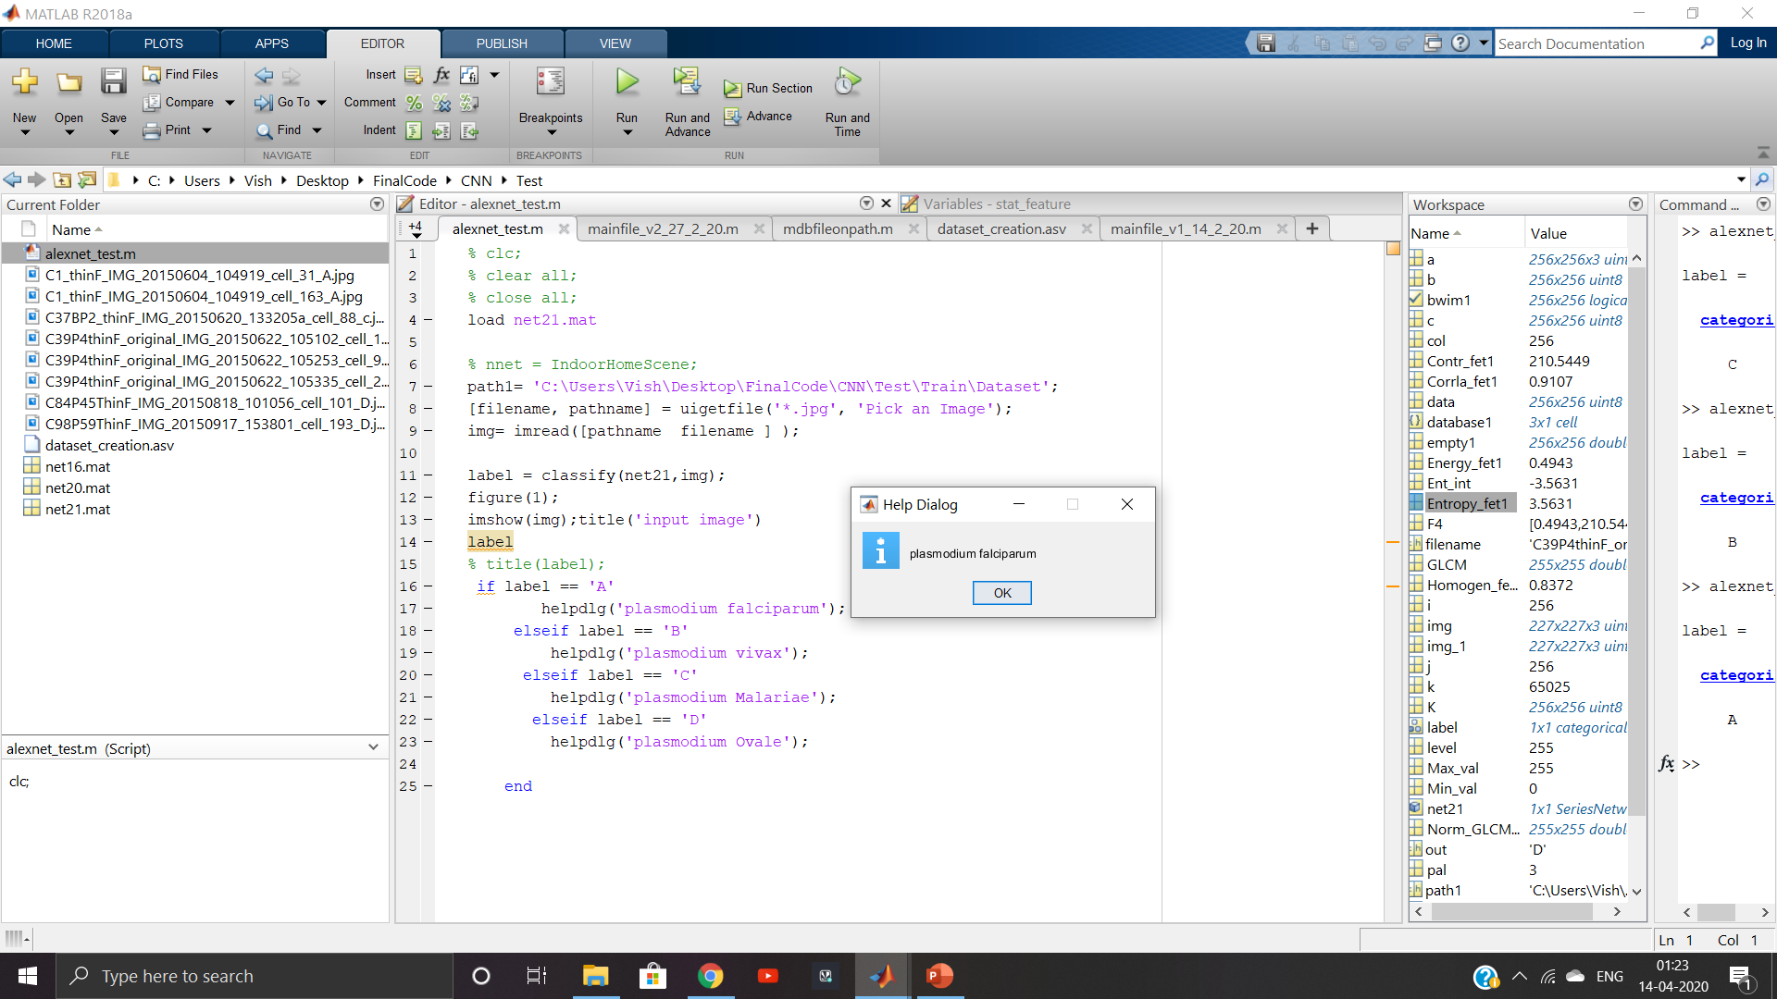
RESULTS - CNN OUTPUT(Contd.,)
Fig. Species of malarial parasite is identified

Slide 32
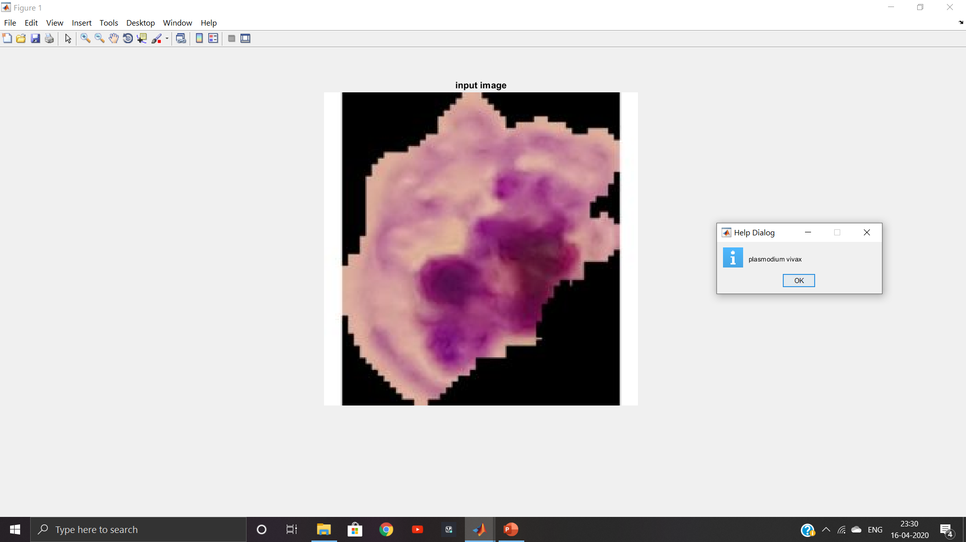
RESULTS - CNN OUTPUT - SPECIES TYPE 2
Fig. Consolidated output of species type- 2

Slide 33
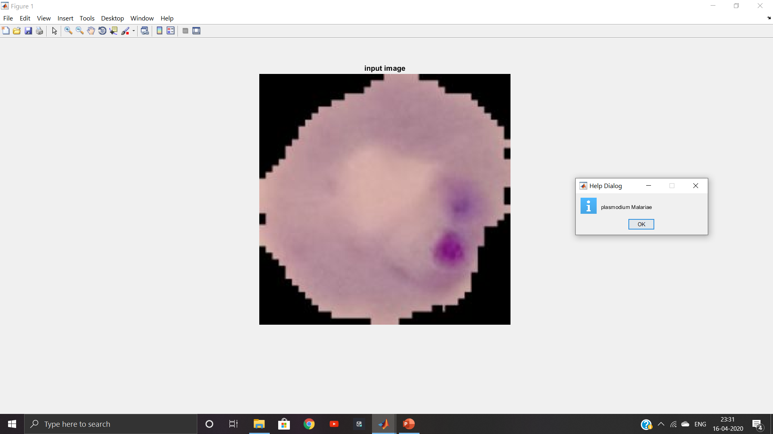
RESULTS - CNN OUTPUT - SPECIES TYPE 3
Fig. Consolidated output of species type- 3

Slide 34
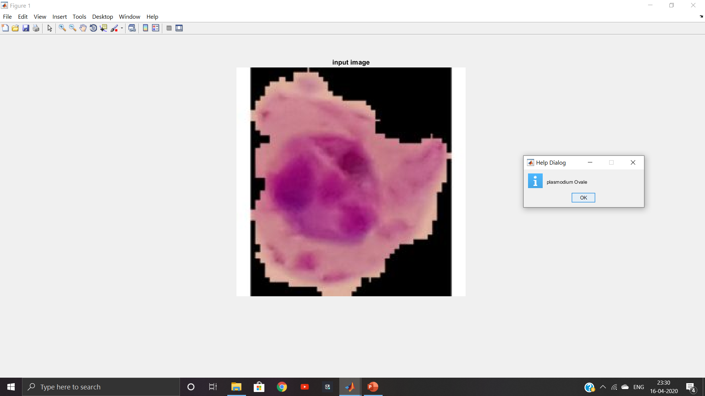
RESULTS - CNN OUTPUT - SPECIES TYPE 4
Fig. Consolidated output of species type- 4

Slide 35
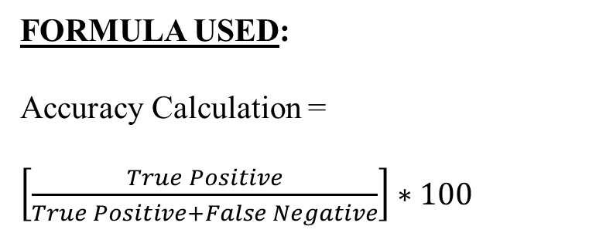
COMPARATIVE ANALYSIS
Table: Number of case types for existing and proposed systems
EXISTING SYSTEM DATA:
Used in reference with base papers mentioned in references [4], [5] and [7]
CASE TYPE | EXISTING SYSTEM | PROPOSED SYSTEM
TRUE POSITIVE | 50 | 75
FALSE POSITIVE | 8 | 3
FALSE NEGATIVE | 10 | 5
Table: Accuracy calculation
FORMULA USED:
Accuracy Calculation =
$\left[\frac{True Positive}{True Positive+False Negative}\right]∗100$
TYPE | SVM(%) | CNN(%)
EXISTING SYSTEM | 83.33 | 86.21
PROPOSED SYSTEM | 93.75 | 96.15

Slide 36
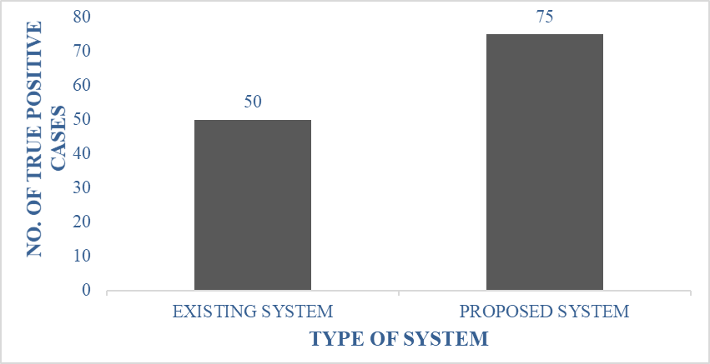
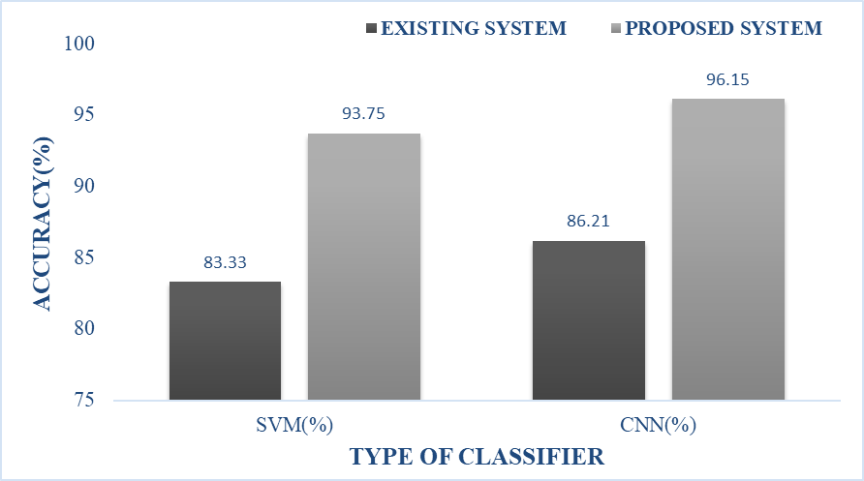
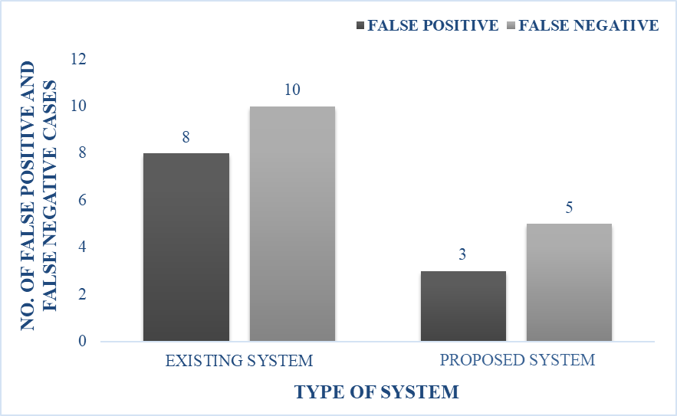
PERFORMANCE ANALYSIS - CHARTS

Slide 37
CONCLUSION
Intends to provide an automated diagnosis of malarial parasites in blood cell images.
Human errors was reduced explicitly.
The desired outcomes can be reproduced whenever required.
Time consuming microscopy-based analysis can be avoided.
FUTURE SCOPE
A low cost, more effective and time saving technique is helpful for real time applications.
Intermittent human intervention is avoided.
Can be used in rural areas as experts may not be present to perform diagnosis.
An extension of the proposed system can be utilized in the detection of other diseases.

Slide 38
TIMELINE CHART
 | JANUARY | FEBRUARY | MARCH | APRIL
WEEK 1 | Literature survey Problem identification | Pre-processing techniques | Feature extraction | Journal paper preparation
WEEK 2 | Abstract preparation PPT presentation (First review ) | De-noising | Classification | Third review preparation
WEEK 3 | Database collection | Second review preparation | Performance analysis
WEEK 4 | Study on Machine Learning tools | Image segmentation | Project report preparation

Slide 39
JOURNAL PUBLICATION
Mrs. A. Usha, N. M. Vishal Kanna, M. Swarna, M. Shyam Ganesh (2020) ‘Detection of Malarial Parasites in Blood Samples Using Image Processing, Machine Learning and Deep Learning’, International Journal of Creative Research Thoughts, Volume 8, Issue 9.

Slide 40
REFERENCES
[1] Daniel Maitethia Memeu et al., (2013) ‘Detection of plasmodium parasites from images of thin blood smears’, International Journal of Engineering Science and Innovative Technology (IJESIT), University of Nairobi, Nairobi, Kenya ,Open Journal of Clinical Diagnostics-3, pp.183-194.
[2] Deepa, A.K. and Vineeta, P.G. (2014) ‘Detection of Malarial Parasites in Blood Images’, International Journal of Engineering Science and Innovative Technology (IJESIT), Vol.3, No.3.
[3] Erik Hablemeyer, Matthias Elter and Thorsten Zerfab (2011) ‘Detection of malarial parasites in thick blood films’, 33rd Annual International Conference.
[4] Hassan Abdelrahman Mohammed and Iman Abuel Maaly Abdelrahman (2017) ‘Detection and Classification of Malaria in Thin Blood Slide Images’, International Conference on Communication, Control, Computing and Electronics Engineering.
[5] Jyothi, R. and Sony, P.L. (2018) ‘Automated Identification and Classification of Malarial Parasites in Thin Blood Smear Images’, International Research Journal of Engineering and Technology.
[6] Khatri, K.M. et al., (2012) ‘Image Processing Approach for Malarial Parasite Identification’, International Journal of Computer Applications, National Conference on Growth of Technologies in Electronics, Telecom and Computers, India: GOTETC.
[7] Kristofer E. delas Penas, Pilarita T. Rivera and Prospero C. Naval Jr., (2017) ‘Malaria Parasite Detection and Species Identification on Thin Blood Smears using a Convolutional Neural Network’, IEEE/ACM International Conference on Connected Health.

Slide 41
REFERENCES
[8] Mark C. Mushabe, Ronald Dendere and Tania S. Douglas, (2013) ‘Automated Detection of Malaria in Giemsa-Stained Thin Blood Smears’, Annual International Conference of the IEEE EMBS.
[9] Prasad, K. et al., (2012) ‘Image Analysis Approach for Development of a Decision Support System for Detection of Malaria Parasites in Thin Blood Smear Images’, Journal of Digital Imaging, Vol.25, No.4, pp.542–549.
[10] Saumya Kareem Reni, (2014) ‘Automated Low-Cost Malaria Detection System in Thin Blood Slide Images Using Mobile Phones’, Ph.D. dissertation, Dept. Sci and Tech., Westminster University, UK.
[11] Suradkar, P. (2013) ‘Detection of Malarial Parasite in Blood Using Image Processing’, International Journal of Engineering and Innovative Technology, Vol.2, No.10.
[12]CDC, (2016) ‘Malaria parasites’ [Online].
Available: https://www.cdc.gov/malaria/about/biology/parasites.html.
[13]WHO, (2016) ‘World Malaria Report 2014 Fact Sheet’ [Online].
Available: http://www.who.int/malaria/publications/world_malaria_report_2014/wmr2014_factsheet.pdf.
[14] Image database links: https://www.kaggle.com/iarunava/cell-images-for-detecting-malaria https://lhncbc.nlm.nih.gov/publication/pub9932

Slide 42
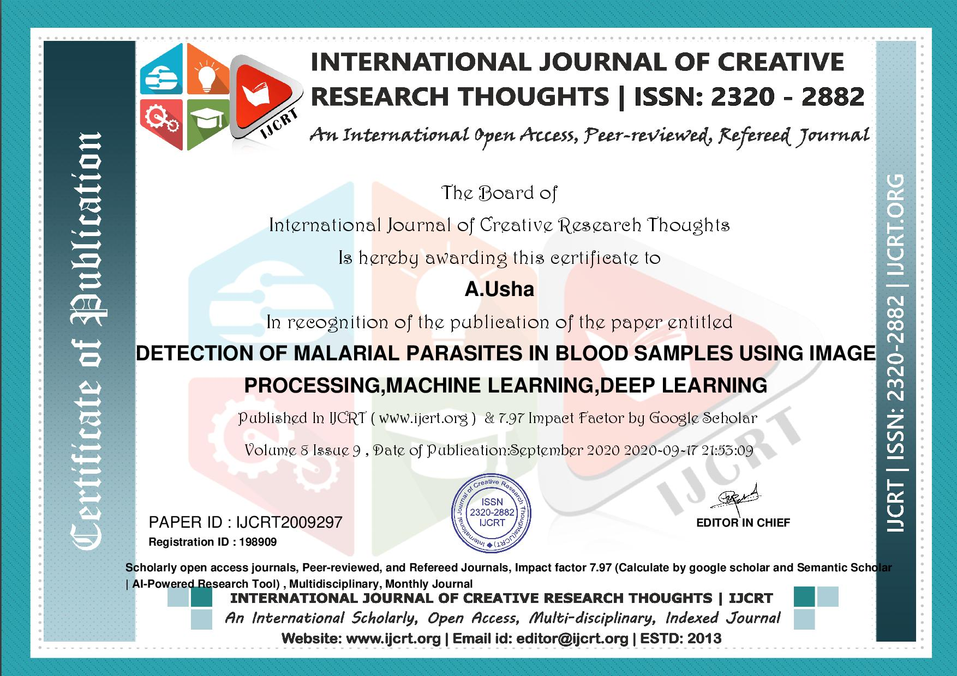
CERTIFICATES

Slide 43
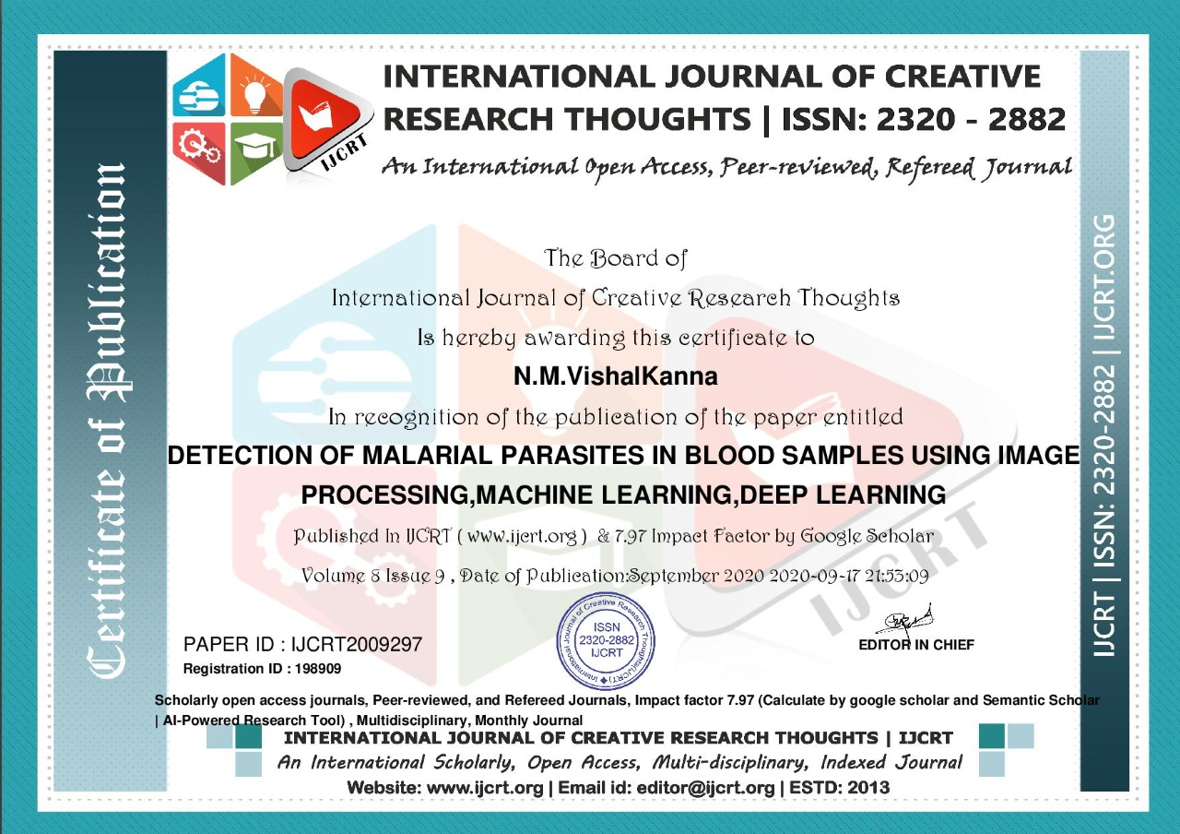
CERTIFICATES (Contd.,)

Slide 44
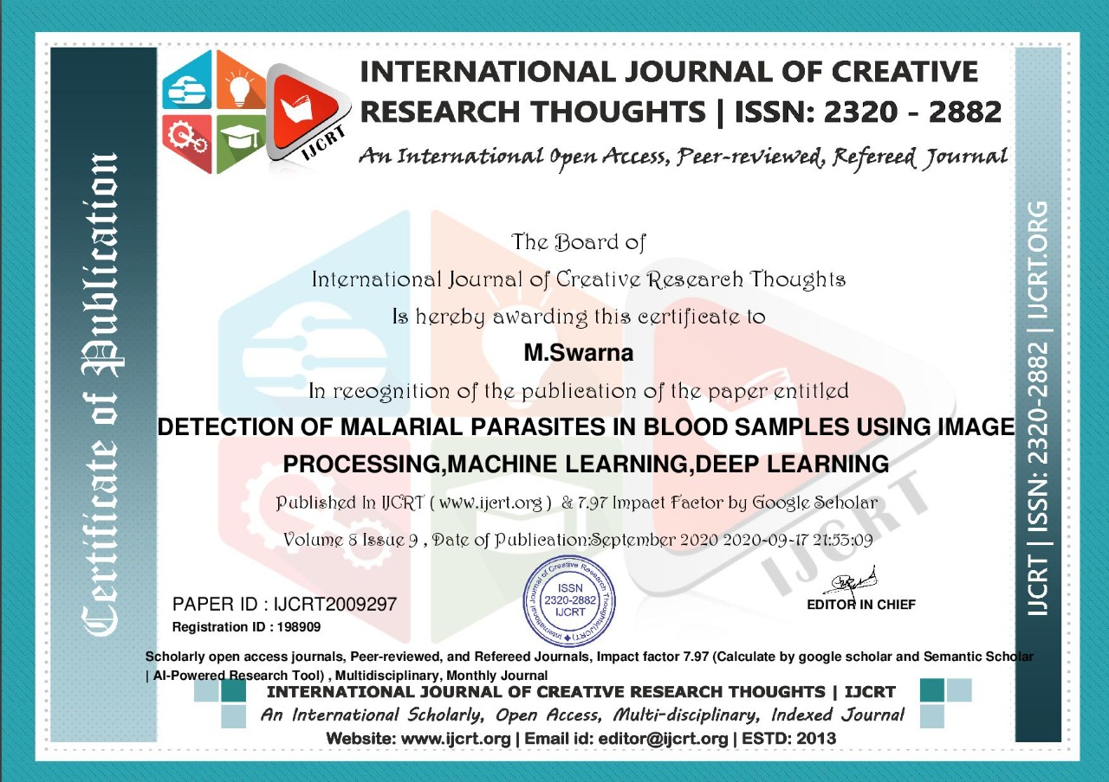
CERTIFICATES (Contd.,)

Slide 45

CERTIFICATES (Contd.,)

Slide 46
THANK YOU!

